Slide 1
Docker File Instructions
dotnetmastery.com

Slide 2
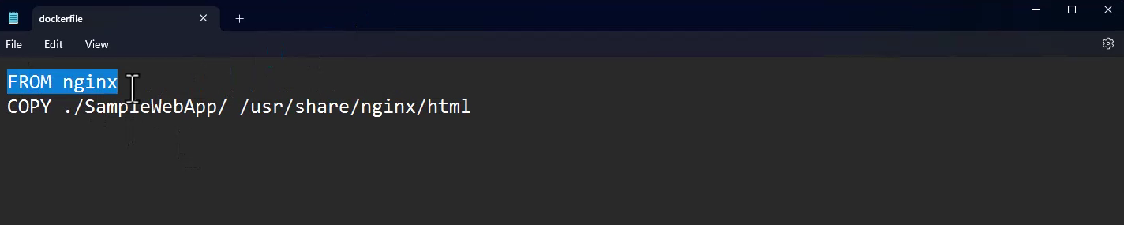
DOCKER File - FROM
Here FROM command is used use nginx for this docker container creation.
dotnetmastery.com

Slide 3
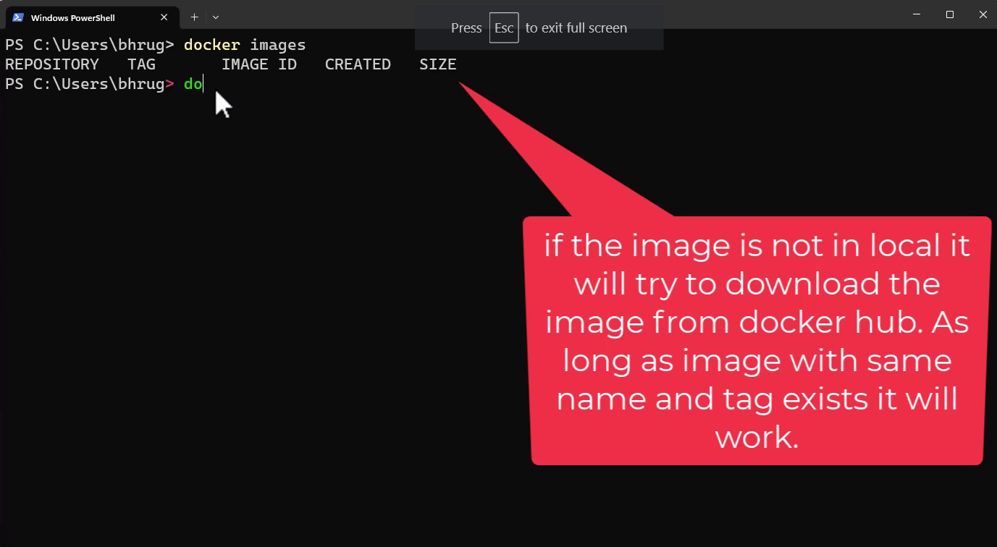
DOCKER File - FROM
dotnetmastery.com

Slide 4
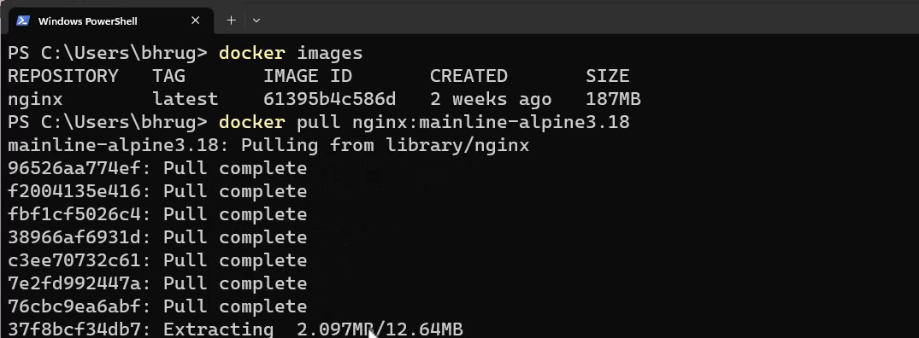
DOCKER – Downloading Tags
docker pull nginx:mainline-alpine3.18
dotnetmastery.com

Slide 5
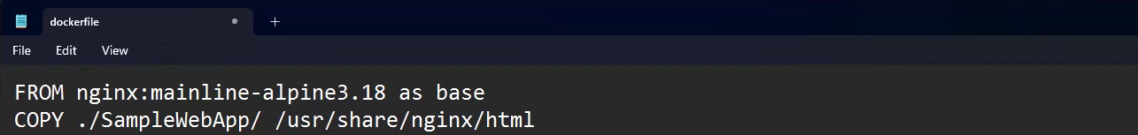
DOCKER File - FROM
Previously we pulled tag related to nginx ,now we can see that tag here:
Now we can use that version tag in the docker file and give a custom name by using “as” .
dotnetmastery.com

Slide 6
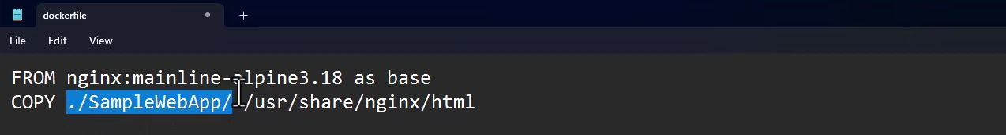
DOCKER File – COPY command
COPY Command is used to define project path.
Followed by period with project name and Destination.
NOTE: Using “.” is the best practice so that it uses relative path.
dotnetmastery.com

Slide 7
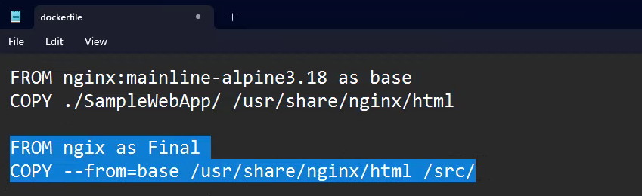
DOCKER File – COPY command
If we want the final build from nginx we can use COPY - –from command.
If we declare = base it will copy files from base image.
Followed by source files and destination location as below, In the final image.
NOTE: Here Base is an alias name and src files copy to final image the.
dotnetmastery.com

Slide 8
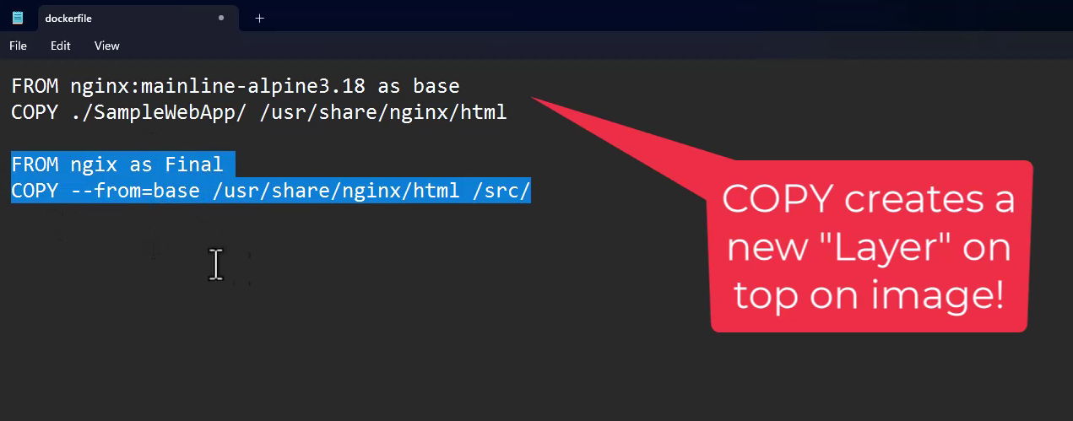
DOCKER File – COPY command
dotnetmastery.com

Slide 9
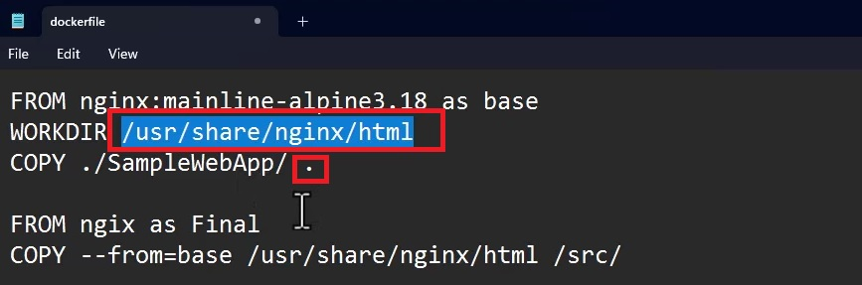
DOCKER File – WORKDIR Command
WORKDIR is used for defining a directory.
And that directory can be used directly in COPY with a period “.”
dotnetmastery.com

Slide 10


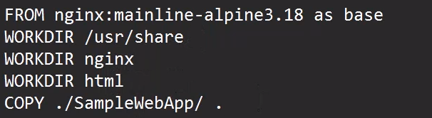
DOCKER File – WORKDIR Command
These will work exactly the same way as below:
NOTE: If the folder we mention in WORKDIR doesn’t exists it will create that folder automatically.
dotnetmastery.com

Slide 11
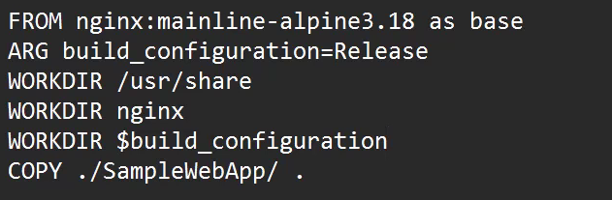
DOCKER File – ARG Command
ARG Command is used to define arguments.
By using $ sign we can use them anywhere in docker file when we want to use that argument in the following way:
Basically, ARG is something like a variable that we declare and use wherever we want in the docker file when needed.
dotnetmastery.com

Slide 12
ARG vs ENV
ARG – used for build time customization
ENV – used for run time customization
dotnetmastery.com

Slide 13
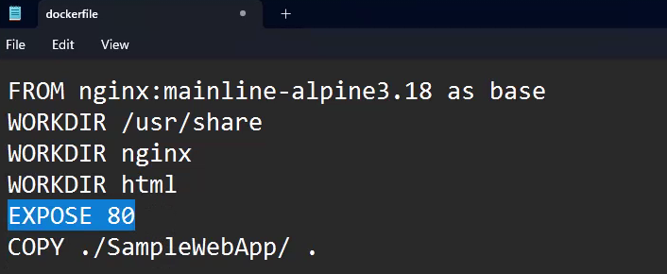
DOCKER File - EXPOSE
EXPOSE is used for documentation purposes.
It will not effect any port mapping.
dotnetmastery.com

Slide 14
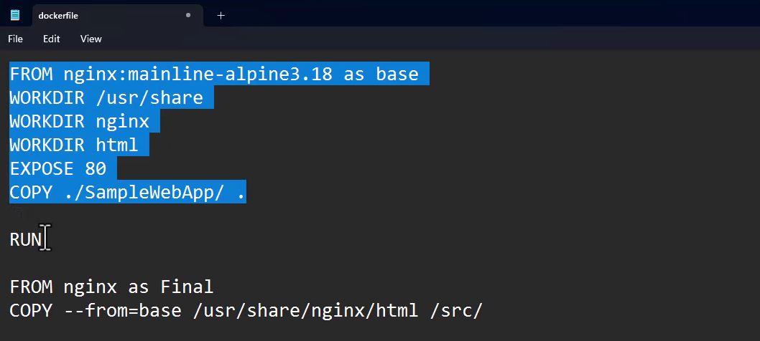
DOCKER File – RUN command
RUN executes any new commands on top of the image as a layer.
dotnetmastery.com

Slide 15
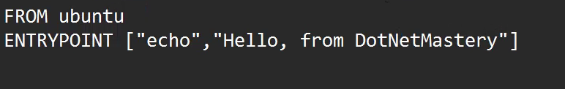
DOCKER File – ENTRYPOINT command
ENTRTYPOINT will execute the executables mentioned when the container is launched.
dotnetmastery.com

